Slide 1

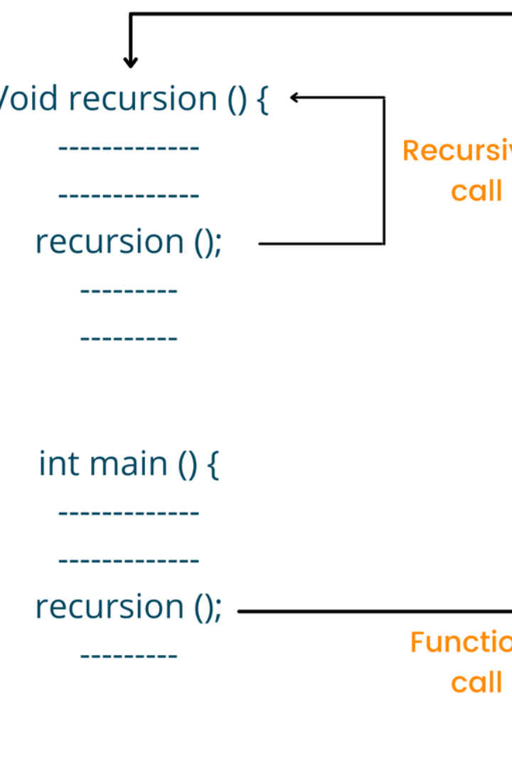
Exploring Recursion in C Language
Welcome to our comprehensive presentation on recursion in the C language. Get ready to dive deep into the concept and discover its power and versatility.

Slide 2

What is Recursion?
Recursion is a programming technique where a function calls itself to solve a problem by breaking it down into smaller, similar subproblems.

Slide 3
Recursive Functions
Recursive functions are functions that call themselves within their own definition. They allow for elegant and concise solutions to complex problems.
Structure
returnType recursiveFunction(parameters) { // Base Case(s) if (baseCaseCondition) { // return base case value } // Recursive Case(s) else { // modify parameters for the next recursive call // make the recursive call returnType result = recursiveFunction(modifiedParameters); // process the result if needed // return the result } }

Slide 4

Base Case and Recursive Case
The base case is the condition that stops the recursion by returning a specific value, while the recursive case is where the function calls itself with a modified subproblem.
int factorial(int n) {
// Base Case: factorial of 0 or 1 is 1 if (n 0 || n 1) { return 1; }
// Recursive Case: factorial of n is n times factorial of (n-1) else { return n * factorial(n - 1); } }

Slide 5

Factorial Example
Let's explore a classic example of recursion - the factorial function. It calculates the product of an integer and all the positive integers below it.
int factorial(int n) { if (n 0 || n 1) { return 1; } else { return n * factorial(n - 1); } }

Slide 6

Fibonacci Sequence Example
The Fibonacci sequence is a famous example of recursion. Each number in the sequence is the sum of the two preceding ones.
void generateFibonacci(int n) { int first = 0, second = 1, next; printf("Fibonacci Sequence up to %d terms:\n", n); for (int i = 0; i < n; i++) { printf("%d, ", first); next = first + second; first = second; second = next; } }

Slide 7

Advantages and Disadvantages of Recursion
Recursion offers an elegant solution to complex problems by breaking them down into smaller, more manageable subproblems. This approach allows for a clearer and more intuitive understanding of the problem at hand. By decomposing the problem into smaller parts, different components of the problem can be tackled individually, leading to more modular and reusable code.
Furthermore, recursion promotes code reusability and readability. Once a recursive function is implemented, it can be easily reused for similar problems, saving time and effort. The recursive approach also tends to result in code that is concise and easier to understand, as it often mirrors the problem-solving thought process more closely.

Slide 8
Conclusion
Recursion is a powerful tool in programming that allows for elegant solutions to complex problems. Understanding its principles can greatly enhance your programming capabilities.

